Slide 1

FAKE NEWS DETECTION
Members:
109705004 何佩蓁
109705009 吳珮慈
109705011 陳盈均 109705051 李語涵

Slide 2
Data Gathering
website for dataset and reference
https://data-flair.training/blogs/advanced-python-project-detecting-fake-news/

Slide 3
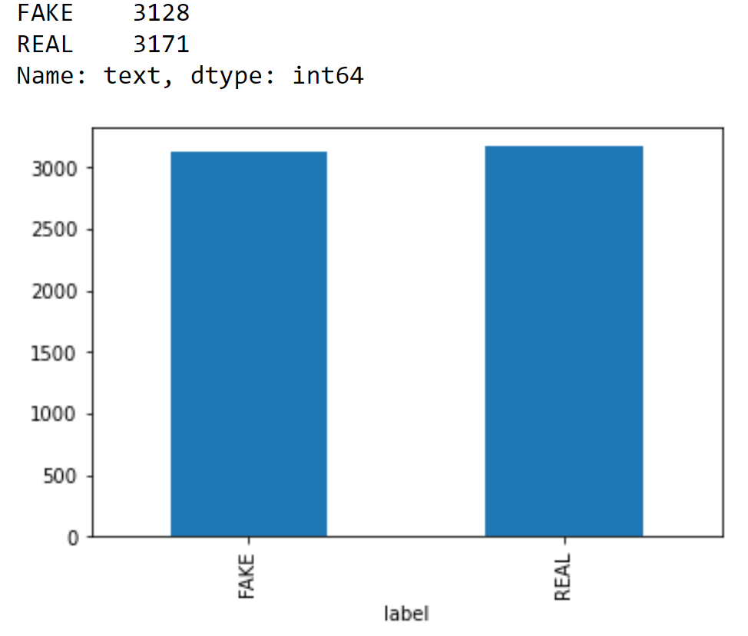
Data processing
1.Deleting rows without text and irrevelent columns
2.Data visualization (Fake:Real = 1:1)
3.Transfering text into usable data by using tifdf_vectorizer
4.Predictions

Slide 4
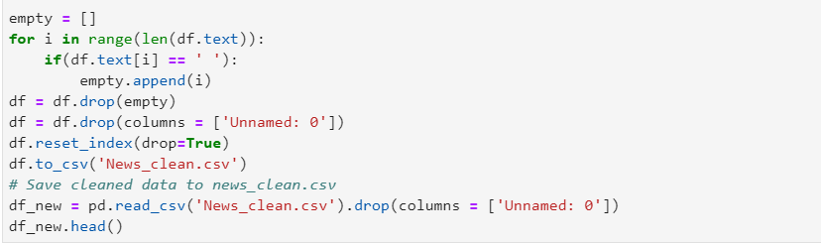

Deleting rows without text and irrevelent columns

Slide 5
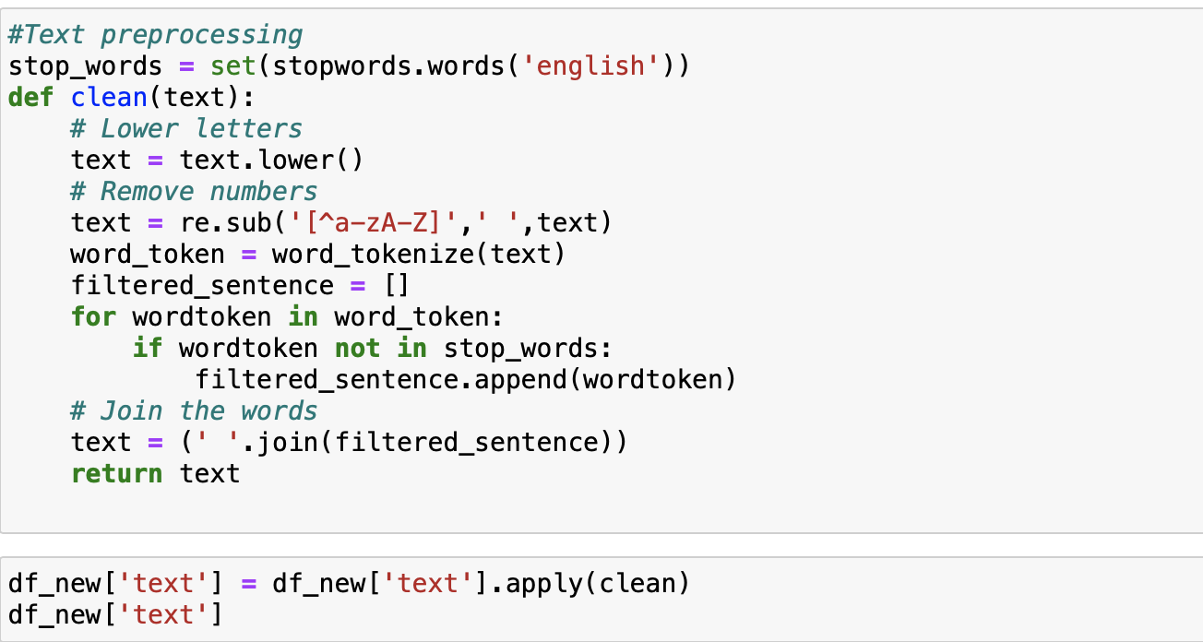
Lowering letters and removing numbers

Slide 6
TfidfVectorizer
TF (Term Frequency): The number of times a word appears in a document is its Term Frequency. A higher value means a term appears more often than others.
IDF (Inverse Document Frequency): Words that occur many times a document, but also occur many times in many others, may be irrelevant. IDF is a measure of how significant a term is in the entire corpus.
The TfidfVectorizer converts a collection of raw documents into a matrix of TF-IDF features.

Slide 7
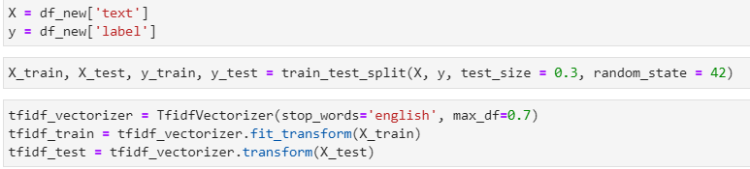
Transfering text into usable data by tifdf_vectorizer

Slide 8
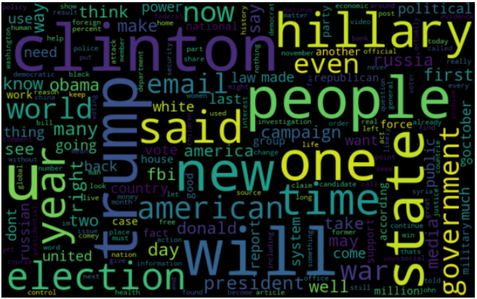
Wordcloud
FAKE

Slide 9
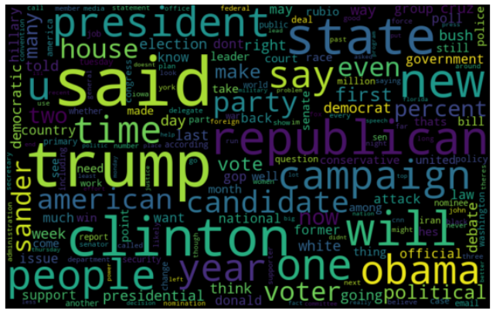
Wordcloud
REAL

Slide 10
Model
Naive Bayes
Logistic Regression
KNN
SVM

Slide 11
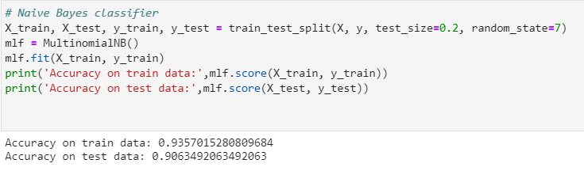
Naive Bayes

Slide 12
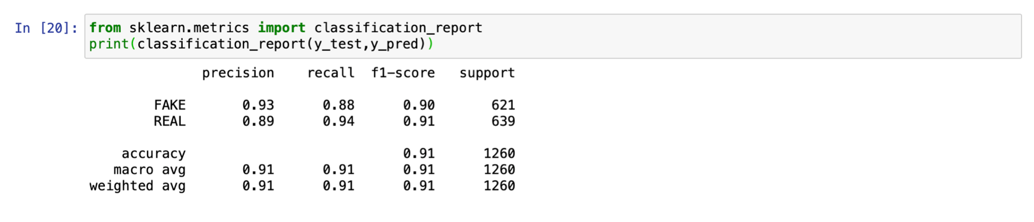
Naive Bayes

Slide 13
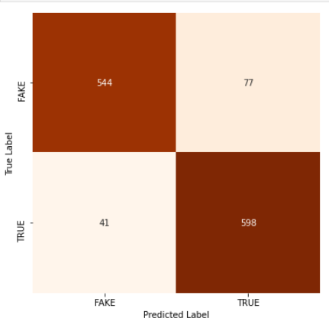
Naive Based-Confusion Matrix

Slide 14
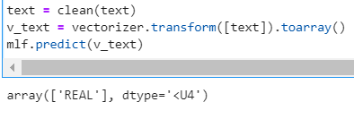
Naive Bayes-Prediction
text:The inauguration of Joe Biden as the 46th president of the United States took place on January 20, 2021, marking the start of the four-year term of Joe Biden as president and Kamala Harris as vice president. The 59th presidential inauguration took place on the West Front of the United States Capitol in Washington, D.C. Biden took the presidential oath of office, before which Harris took the vice presidential oath of office.
actual:REAL
predict:REAL

Slide 15
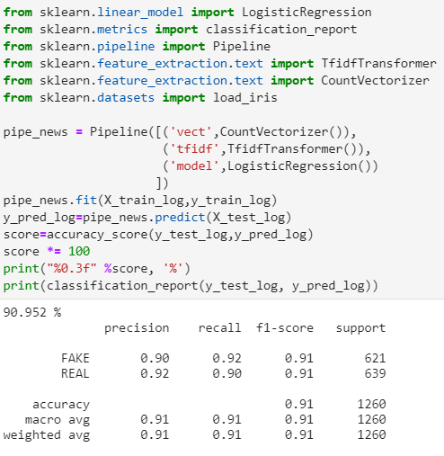
Logistic Regression

Slide 16
Logistic Regression
accuracy:90.952%

Slide 17
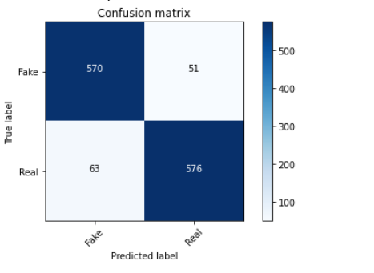
Logistic Regression-Confusion Matrix

Slide 18
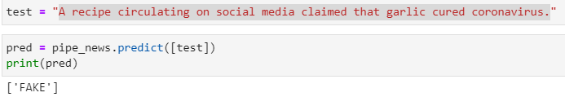
Logistic Regression-Prediction
text:A recipe circulating on social media claimed tha garlic cured coronavirus.
actual-Fake
prediction-Fake

Slide 19
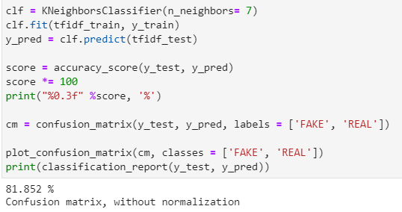
KNN

Slide 20
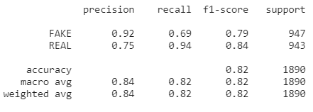
KNN
accuracy:81.852%

Slide 21
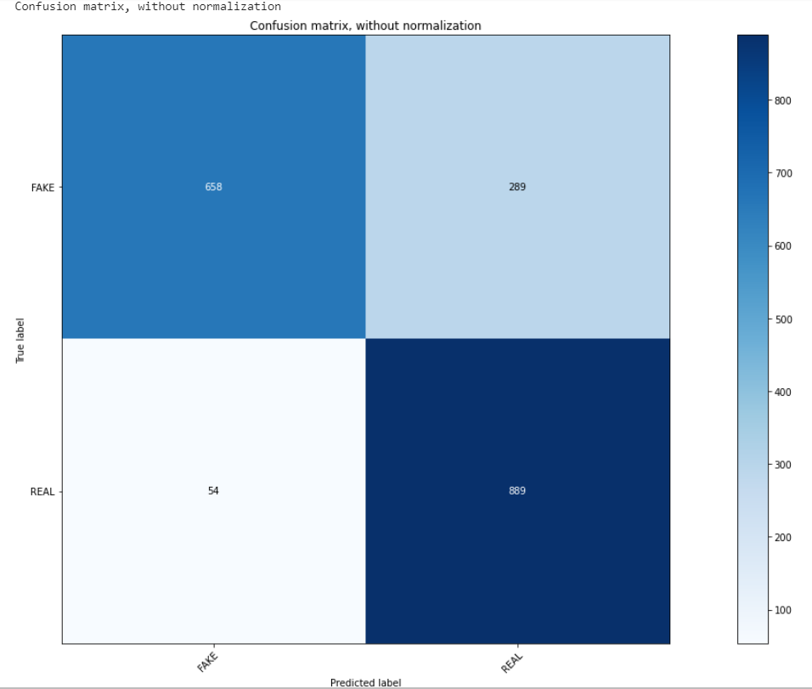
KNN-Confusion Matrix

Slide 22
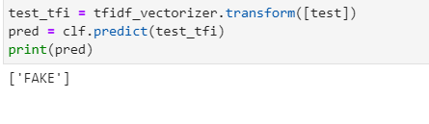
KNN-Prediction
text:Good news, Wuhan’s coronavirus can be cured by one bowl of freshly boiled garlic water. Old Chinese doctor has proven its efficacy. Many patients has also proven this to be effective. Eight (8) cloves of chopped garlics add seven (7)cups of water and bring to boil. Eat and drink the boiled garlic water, overnight improvement and healing. Glad to share this.
actual:FAKE
predict:FAKE

Slide 23
SVM-Introduction
Support Vector Machine(SVM) is a machine learning model based on statistical learning theory
Relative advantages for small samples, non-linearity, high dimensionality and local minimum
In addition to great contribute to text classification, image classification, and protein classification in medicine, it also has a wide range of applications in industry due to its fast calculation speed and low space cost.
Notes:
效能較不佳，由於時間複雜度為O(n²)當有超過一萬筆資料時，運算速度會慢上許多
優點: 1.使用核函數可以有效處理高維數據 2. 透過不同核函數的選擇，可以處理不同的資料 3. 決策函數由少量的支持向量決定，預測效率高
缺點: 1. 維度過高容易造成運算上的負擔 2.特徵遠大於樣本的情況下容易造成過度擬和的問題
SVM is not suitable for large datasets because of its high training time and it also takes more time in training compared to Naïve Bayes. It works poorly with overlapping classes and is also sensitive to the type of kernel used.
Guaranteed Optimality: Owing to the nature of Convex Optimization, the solution will always be global minimum not a local minimum.

Slide 24
SVM-Introduction
How does SVM work?

Slide 25
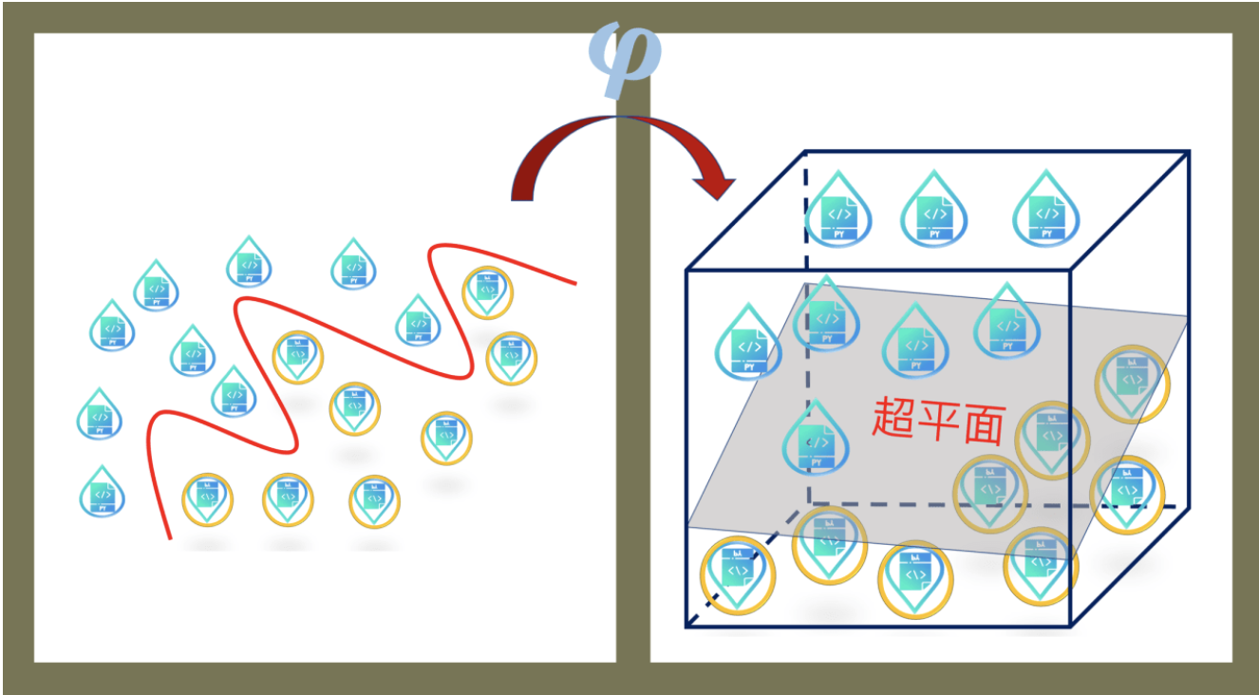
SVM-Introduction
1.SVM maps the linearly inseparable samples in the low-dimensional space to the high-dimensional space.

Slide 26
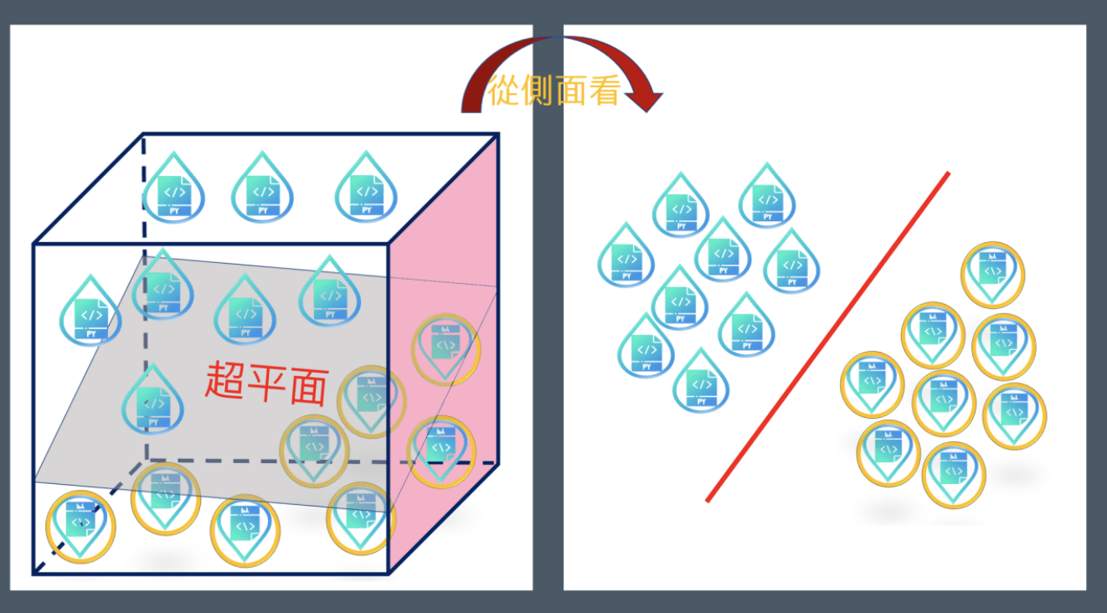
SVM-Introduction
2.Find a hyperplane to effectively cut these samples, and the samples on both sides of the hyperplane should be as far away as possible from the hyperplane.

Slide 27
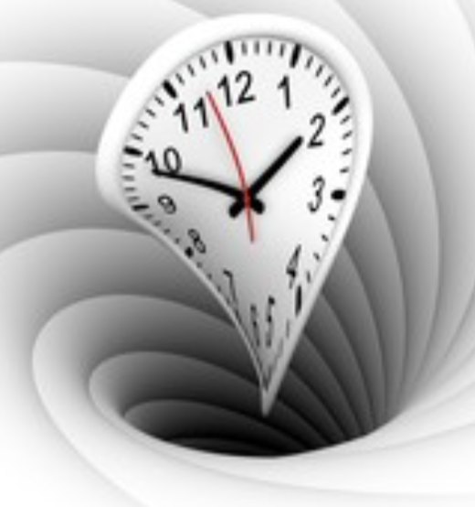
SVM-Introduction
The kernel functions return the inner product between two points in a suitable feature space.
3.Find a line to maximize the Margin using Kernel Function!
Imagine that if we want to map a sample that was originally only in a 2-dimensional space to an ultra-high dimension…...
(for example, 3000 dimensions)

Slide 28
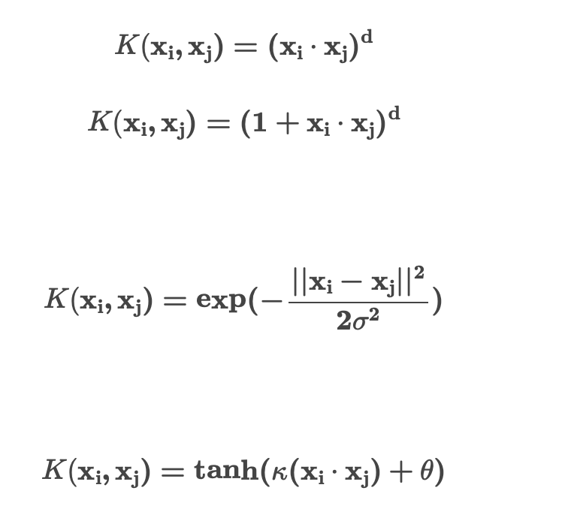
SVM-Introduction
Multiple kernel function:
Gaussian kernel function:
Sigmoid kernel function:

Slide 29
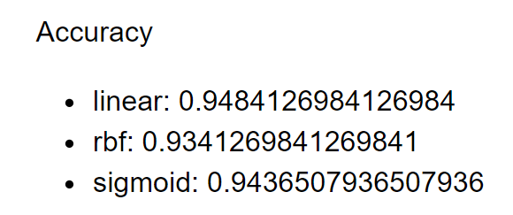
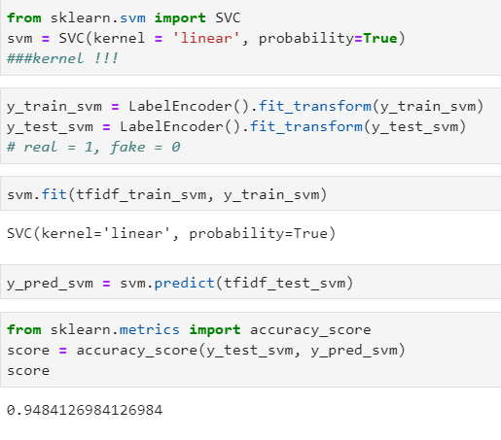
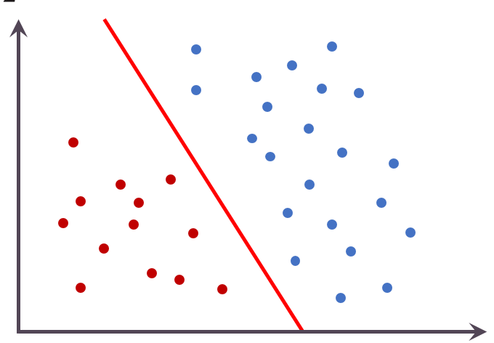
SVM

Slide 30
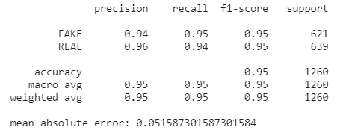
SVM

Slide 31
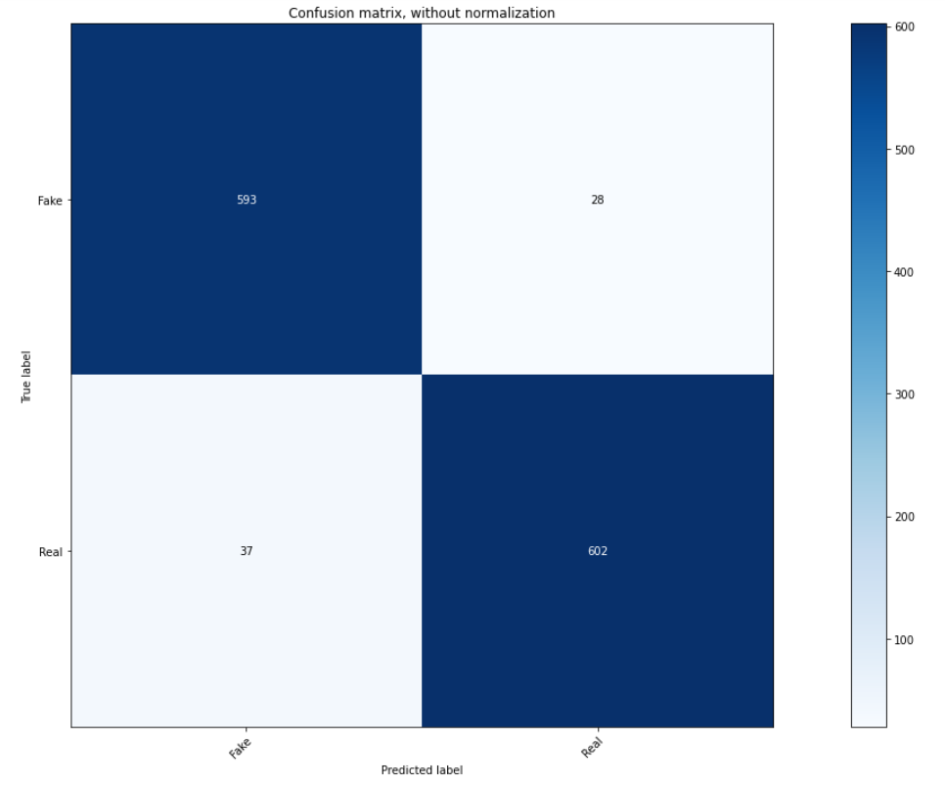
SVM-Confusion Matrix

Slide 32
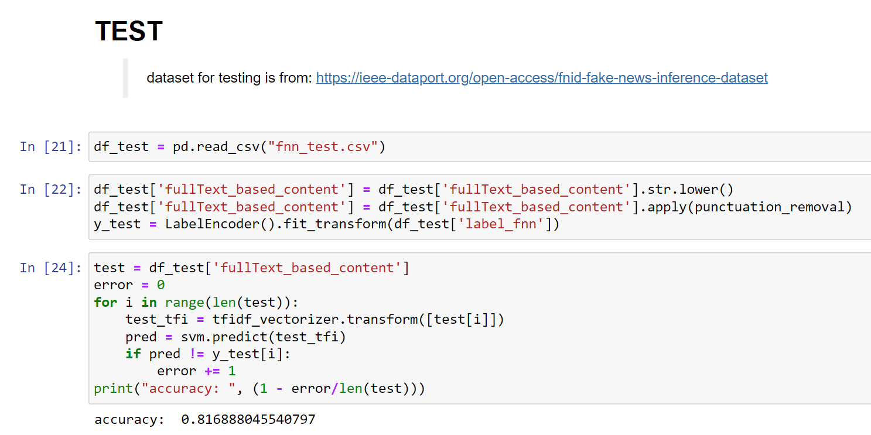
SVM-Prediction
Accuracy
y_test_svm: 0.9484
fnn_test: 0.8189

Slide 33

Logistic Regression
Naive Bayes
KNN
SVM

Slide 34

THE END

